Slide 1
Machine Learning
UNIT-I
Introduction to Machine Learning:
Evolution of machine Learning, Paradigms for ML, Learning by Rote, Learning by Induction, Reinforcement Learning, Types of Data, Matching, Stages in Machine Learning, Data Acquisition, Feature Engineering, Data Representation, Model Selection, Model Learning, Model Evaluation, Model Prediction, Search and Learning, Data Sets.

Slide 2
Text Books:
1. “Machine Learning Theory and Practice”, M N Murthy, V S Ananthanarayana, Universities Press (India), 2024
Reference Books:
“MachineLearning”,TomM.Mitchell,McGraw-HillPublication,2017
“Machine Learning in Action”, Peter Harrington, DreamTech
“Introduction to Data Mining”, Pang-Ning Tan, Michel Stenbach, Vipin Kumar,7th Edition, 2019.

Slide 3
Definition
Machine Learning is the science (and art) of programming computers so they can learn from data.
[Machine Learning is the] field of study that gives computers the ability to learn without being explicitly programmed. —Arthur Samuel, 1959

Slide 4
Engineering Definition
A computer program is said to learn from experience E with respect to some task T and some performance measure P, if its performance on T, as measured by P, improves with experience E. —Tom Mitchell, 1997
Example: Spam Filter

Slide 5
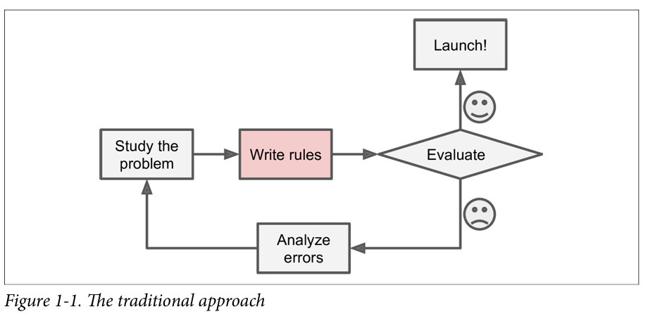
Why Use Machine Learning?
Consider how you would write a spam filter using traditional programming techniques.

Slide 6
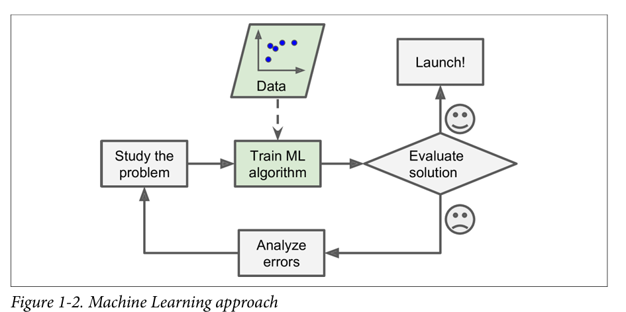
Machine Learning Approach

Slide 7
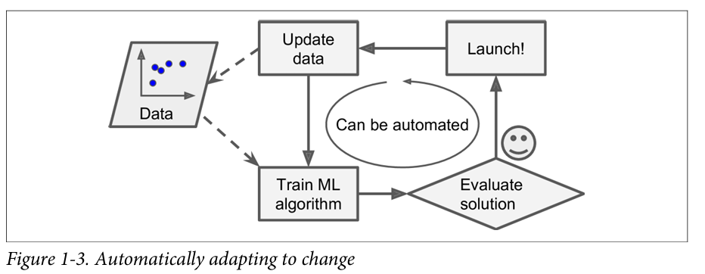
Adopting to change

Slide 8
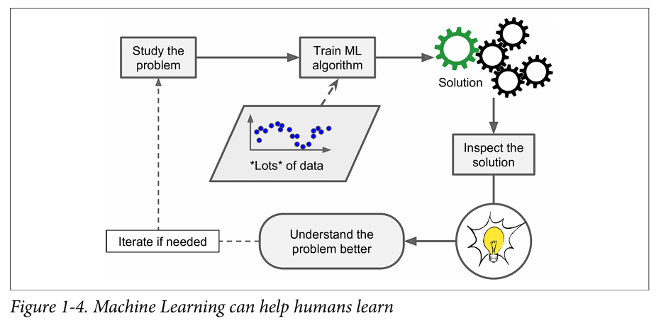
Learning

Slide 9
Machine Learning is great for:
• Problems for which existing solutions require a lot of hand-tuning or long lists of rules: one Machine Learning algorithm can often simplify code and perform bet ter.
• Complex problems for which there is no good solution at all using a traditional approach: the best Machine Learning techniques can find a solution.
• Fluctuating environments: a Machine Learning system can adapt to new data.
• Getting insights about complex problems and large amounts of data.

Slide 10
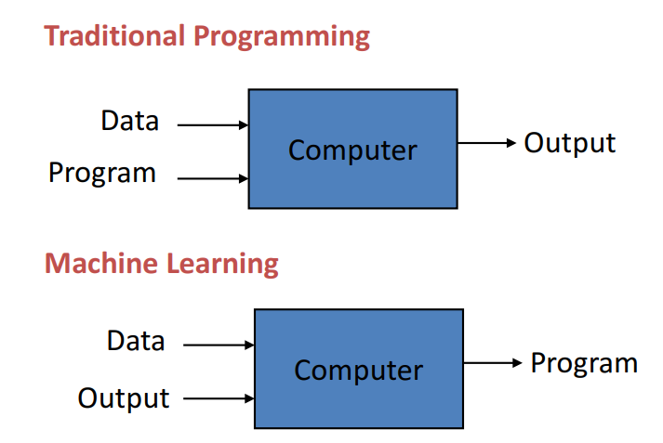

Slide 11
Machine Learning Paradigms
Machine Learning is generally categorized into three paradigms. They are:
Supervised Learning
Unsupervised Learning
Reinforcement Learning

Slide 12
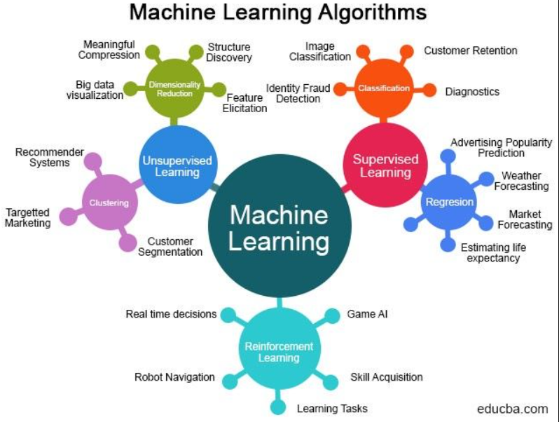
Machine Learning Paradigms

Slide 13
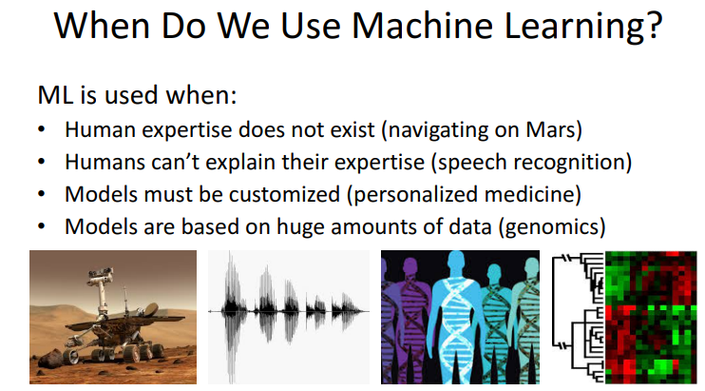

Slide 14
Types of Supervised learning
Classification: A classification problem is when the output variable is a category, such as “red” or “blue” or “disease” and “no disease”.
Regression: A regression problem is when the output variable is a real value, such as “dollars” or “weight”.

Slide 15
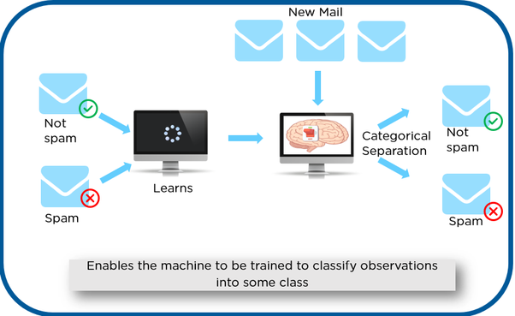
Classification

Slide 16
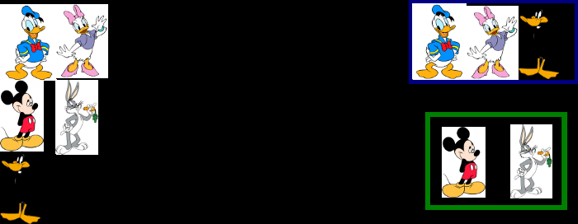
Classification

Slide 17
Types of Unsupervised learning
Clustering: A clustering problem is where you want to discover the inherent groupings in the data, such as grouping customers by purchasing behaviour.
Association: An association rule learning problem is where you want to discover rules that describe large portions of your data, such as people that buy X also tend to buy Y.

Slide 18
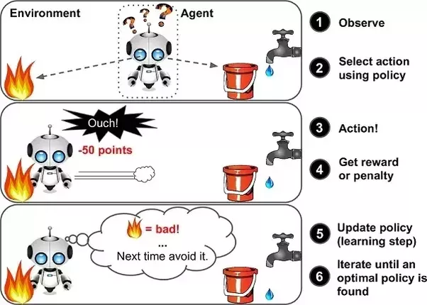
Reinforcement Learning

Slide 19
ML Paradigms
Supervised Learning
-learn an input and output map
Classification: categorical output
Regression: continuous output
Unsupervised Learning
- Discover patterns in the data
clustering: cohesive grouping
Association: frequent cooccurance
Reinforcement Learning
- Learning Control

Slide 20
Machine Learning Tasks
TASK | MEASURE
Classification | error
Regression | error
Clustering | Scatter/purity
associations | Support/confidence
Reinforcement Learning | Cost/reward

Slide 21
Classification Applications
Credit card fraud detection
-valid transaction or not
Sentiment Analysis
-opinion mining, buzz analysis, etc.
Medical diagnosis
- Risk Analysis

Slide 22
Regression Applications
Time series Prediction
- Rain fall in a certain region
- Spend on voice calls
Trend analysis
- Linear or exponential
Risk factor analysis
- factors contributing most to the output

Slide 23
Clustering Applications
Customer data
- Discover classes of customers
Image pixels
- Discover Regions
Words
- synonyms
Documents
- Topics

Slide 24
Association Rule Mining
Mining frequent patterns and rules
Association rules: conditional dependencies
Two stages
- find frequent patterns
- derive associations (A=>B) from frequent patterns
Find patterns in
- sequences (time series data, fault analysis)
- Transactions (market basket data)
- Graphs ( social network analysis )

Slide 25
Association Rule Mining Applications
Market basket analysis
Predicting co-occurence
Time series analysis
- trigger events

Slide 26
Reinforcement Learning
Game playing
Adaptive control

Slide 27
Spam Mail detection learning problem
Task T: To recognize and classify emails into ‘spam’ or ‘not spam’.
Performance measure P: Total percent of mails being correctly classified as ‘spam’ (or ‘not spam’ ) by the program.
Training experience E: A set of mails with given labels (‘spam’ / ‘not spam’).

Slide 28
Handwriting recognition learning problem
For handwriting recognition learning problem, TPE would be,
Task T: To recognize and classify handwritten words within the given images.
Performance measure P: Total percent of words being correctly classified by the program.
Training experience E: A set of handwritten words with given classifications/labels.

Slide 29
Checkers learning problem
For a checkers learning problem, TPE would be,
Task T: To play checkers
Performance measure P: Total percent of the game won in the tournament.
Training experience E: A set of games played against itself

Slide 30
If we are able to find the factors T, P, and E of a learning problem, we will be able to decide the following three key components:
1. The exact type of knowledge to be learned (Choosing the Target Function)
2. A representation for this target knowledge (Choosing a representation for the Target Function)
3. A learning mechanism (Choosing an approximation algorithm for the Target Function)

Slide 31
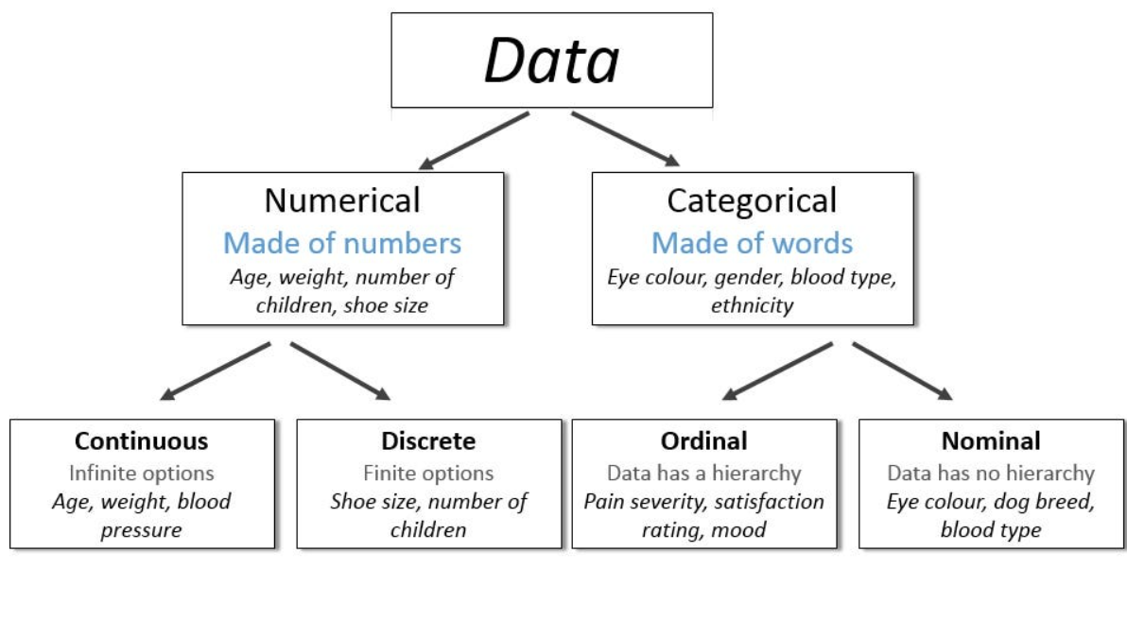
Types of Data

Slide 32
Matching
Matching is carried out by using proximity measure which can be a distance/Dissimilarity /similarity measure.
Two data items u and v represented as n dimensional vectors, match better when the distance between them is smaller or when the similarity between them is larger.
Euclidean distance- distance measure
Cosine of the angle between vectors- similarity measure

Slide 33
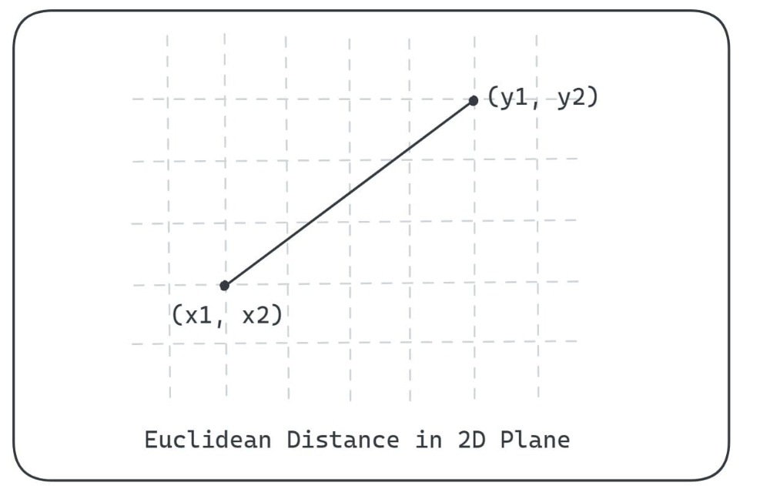
Euclidean distance

Slide 34
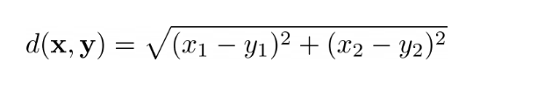
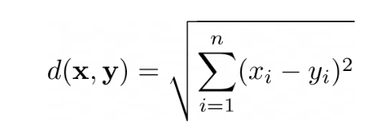
This distance is given by the square root of the sum of the squared differences between the corresponding coordinates of the two points. Mathematically, the Euclidean distance between the points x and y in two-dimensional plane is given by:
Extending to n dimensions, the points x and y are of the form x = (x1, x2, …, xn) and y = (y1, y2, …, yn), we have the following equation for Euclidean distance:

Slide 35

Cosine of the angle between vectors
Cosine Similarity only considers the angle between vectors, regardless of their magnitude (length). To calculate the cosine similarity between two vectors, one can simply divide the dot product of both vectors by the product of their lengths. This scales the vector magnitudes to 1. Thus cosine similarity is invariant to vector magnitude. It’s particularly useful when you want to compare vectors based purely on their directional similarity.
The formula to find the cosine of the angle θ\theta between two vectors A and B is:

Slide 36
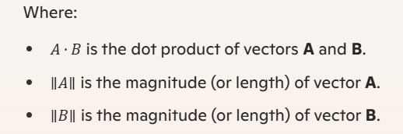
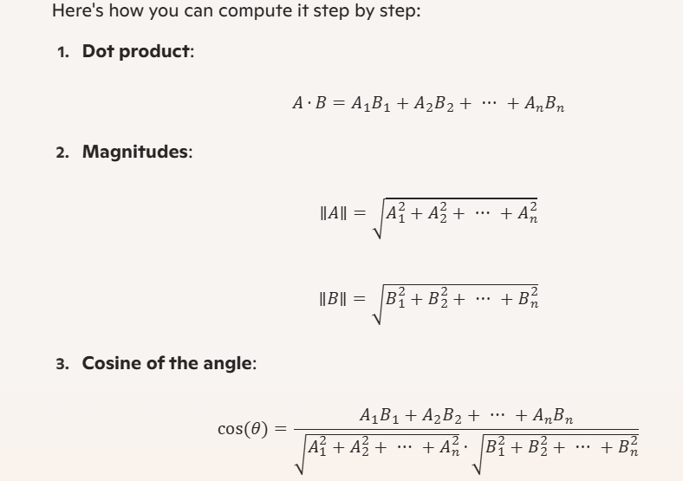

Slide 37
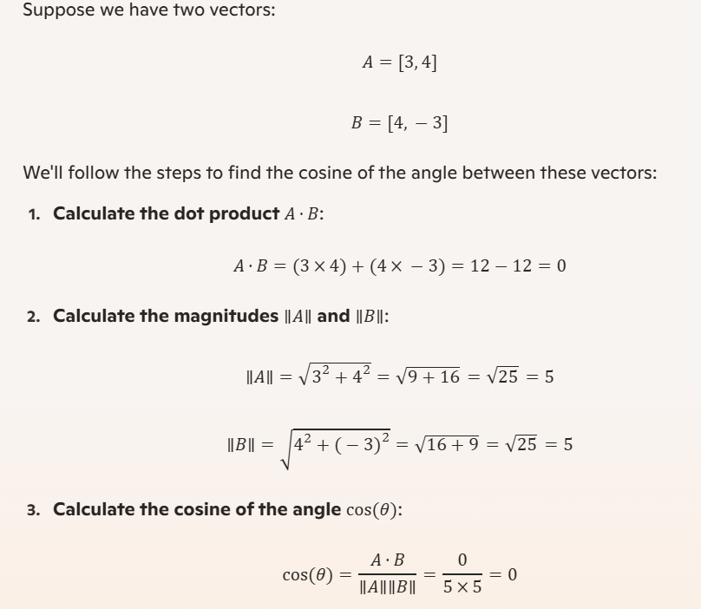
So, the cosine of the angle between vectors A and B is 0, indicating that the vectors are perpendicular to each other (orthogonal).

Slide 38
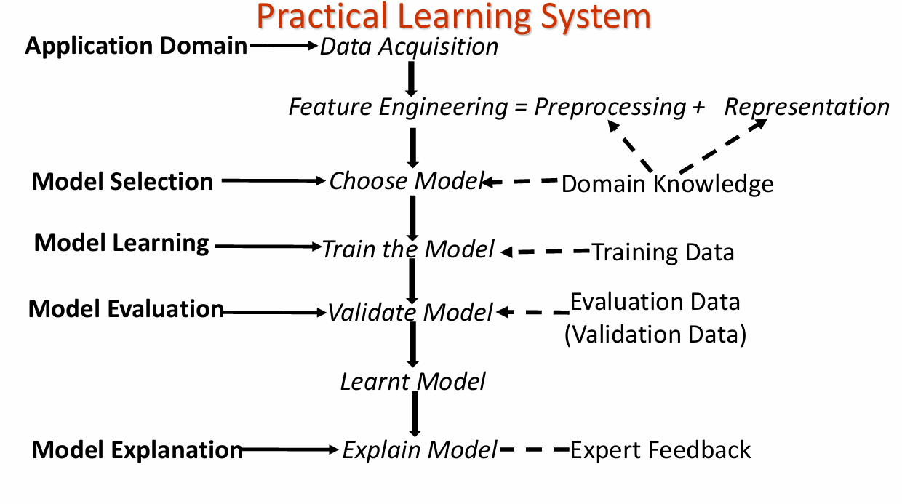
Stages in Machine Learning

Slide 39
Data Acquisition

Slide 40
Feature Engineering
Data Preprocessing:
1. Missing Data
2. Different ranges for different variables
3. outliers
1. Missing Data:
use the nearest neighbor
use a larger neighborhood
cluster the data and locate the nearest cluster

Slide 41
2. Different ranges for different variables
Ex: consider the height and weight vector of adult and child. (1.6,75000) (0.6, 5000)
Normalization
1. Scaling using the range
2. Standardization

Slide 42
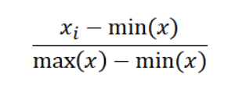
Min-Max Scaling
Min Max Scaling transforms all values to a fixed range, typically between 0 and 1, by subtracting the minimum value and dividing by the range.

Slide 43
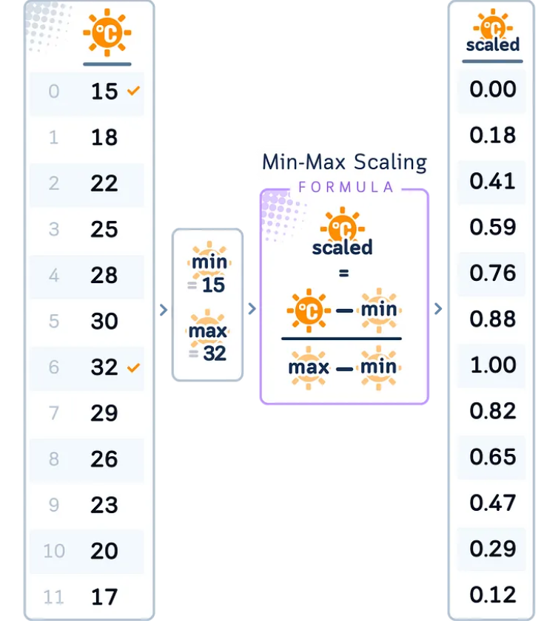
Example

Slide 44
Standardization
Standardization is a scaling technique that transforms features to have a mean of 0 and a standard deviation of 1. In other words, it centers the feature values around 0 and scales them to have unit variance. This is achieved by subtracting the mean value of each feature and then dividing by the standard deviation of the feature:
z = (x – μ) / σ
where z is the standardized value, x is the original feature value, μ is the mean of the feature values, and σ is the standard deviation of the feature values.
For example, let‘s say we have a dataset with a feature called "age" that has the following values:

Slide 45

[25, 30, 35, 40, 45]The mean of these values is 35 and the standard deviation is 7.91. To standardize the "age" feature, we would perform the following calculation on each value:
z = (x – 35) / 7.91
So the standardized "age" values would be:
[-1.26, -0.63, 0.0, 0.63, 1.26]As you can see, the standardized values are centered around a mean of 0 and have a standard deviation of 1.

Slide 46
3. outliers
Outlier is an observation in a given dataset that lies far from the rest of the observations. That means an outlier treatment is vastly larger or smaller than the remaining values in the set.

Slide 47
Data Representation
Feature selection involves selecting a subset of relevant features from the original set of features. The goal is to reduce the dimensionality of the feature space, simplify the model, and improve its generalization performance.
Feature extraction involves transforming the original features into a new set of features that are more informative and compact. The goal is to capture the essential information from the original features and represent it in a lower-dimensional feature space. Feature extraction methods can be categorized into linear and nonlinear methods:
Linear Methods: These use linear transformations such as Principal Component Analysis (PCA) and NMF extract features.
Nonlinear Methods: These use nonlinear transformations such as Kernel PCA and Autoencoder to extract features

Slide 48
Principal Component Analysis (PCA)
The PCA algorithm can be broken down into the following steps:
Standardize the dataset
Compute the covariance matrix
Calculate the eigenvectors and eigenvalues of the covariance matrix
Sort the eigenvectors by decreasing eigenvalues
Choose k eigenvectors as the new features
Transform the original dataset

Slide 49

Nonnegative Matrix Factorization
NMF may factorize a matrix A with dimensions of m x n, where every element is ≥ 0. The resulting two matrices, W and H, have respective dimensions of m x k and k x n, and they exclusively include nonnegative components. Matrix A is defined here as:

Slide 50
Non-linear feature extraction
Autoencoders are a type of neural network used for unsupervised learning, The aim of an autoencoder is to learn a lower-dimensional representation (encoding) for a higher-dimensional data, typically for dimensionality reduction, feature learning, or generative modelling.

